Slide 1
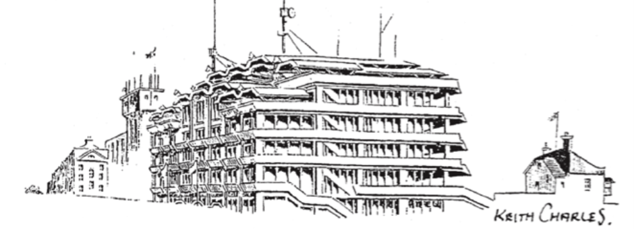
Epsom Derby Festival Q&A session Friday 12th July 2024 at 7:00pm Place: Langley Vale Village Hall

Slide 2
Agenda
Welcome, Intros/Aim of meeting
Introduction to the panel, ground rules for the evening and desired outcomes outlined.
Questions and Answers session
Several questions have been gathered ahead of the meeting and circulated to the panel.
Once these have been worked through then questions will be taken from the floor.
Moving forward
Commitments from stakeholders on how we can all come together to better protect LV during the Derby Festival
4. Communications
Discuss improvements on how do we communicate problems, to whom, what telephone number should all use to get a response?
5. Thanks and Close the meeting – 09:30pm at the latest.
Confirm next steps, minutes and close the meeting.

Slide 3
1. Welcome, Intros/Aim of meeting
Introduction to the panel, ground rules for the evening and desired outcomes outlined.
Steven McCormick – Borough and County Councillor and Chair of the Epsom Downs Conservators – Co Chair for this evening.
Sean Porter – Langley Vale Village Hall Chair – Co Chair for this evening
Inspector Clifton-Sinclair – Borough Commander, Epsom & Ewell
Tom Sammes – General Manager, Epsom Downs, The Jockey Club
Bernice Froud – Borough Councillor and Epsom Downs Conservator
Liz Frost – Borough Councillor and Epsom Downs Conservator
Guest in attendance – Helen Maguire MP

Slide 4
2. Questions and Answers session Suggest red questions directed to Police and those in blue to the Jockey Club.
“We reported gunshots in the woods on 24th May 2024 via both 101 and 999, why were we not taken seriously?
After the first actual incident (Wednesday 29th, at Dan Malloy's house in Grosvenor Road) our fears that things were not right were confirmed. Why was there no more police presence?
The next day (30th May) we, and several other houses were hit with 9mm steel shot, causing thousands of pounds of damage. Simultaneously, we and other neighbours, reported more gunshots in the woods. This led to armed police arriving.
After this incident we were given an overall reference number by the armed police, but no specific crime number to use. Why?
The PCSOs then visited on 1st June but had no idea that we were one of the victims of the damage, there was nothing on file connecting our property to the events of 30th, we had to work it through with them, in order to link all the events together, but have no idea who else was involved.
In this case, have all the events of the 30th been connected and investigated?
Why has there been no follow up from the police since then?

Slide 5
2. Questions and Answers session – cont.
We are aware some neighbours contacted the police command centre at the grandstand to report the issues and were told 'there is nothing we can do from here' - why?
The police were posting about their pro-active approach to policing the event, on social media. This is factually incorrect, why was there no police patrolling in Langley Vale before the event, and why were they not reactive to reports of gunshots before and during the weekend?
Why is Langley Vale outside the temporary dispersal area and sites, such as the RAC and golf course inside it? There has to be a logical reason, we are told it's because it's an emergency route but that would make sense if it was inside the dispersal area, not outside?
Did the Surrey/Sussex firearms licensing office receive reports and check on firearms license holders in Langley Vale?
What the concrete/solid plans for policing the event in 2025, given the Jockey Club plan to extend the event to a week. how will Langley Vale be protected better?
Why does the Jockey Club not see this as their corporate social responsibility, given their two closest neighbours, Langley Vale and Tattenham corner, both experienced crime this year?
Last question, why is only the bottom of Langley Vale coned off to prevent parking? This forces people to park at the top, which is closer to the event. I'm requesting that at least Rosebery Road is coned bottom to top.

Slide 6
3. Moving forward
Commitments from stakeholders on how we can all come together to better protect Langley Vale during the Derby Festival

Slide 7
4. Communications
Discuss improvements on how do we communicate problems, to whom, what telephone number should all use to get a response?

Slide 8
5. Thanks and Close the meeting
Thanks and Close the meeting – 09:30pm at the latest.

