Slide 1
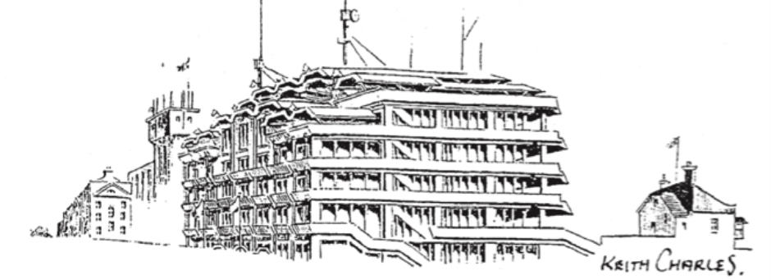
Epsom Derby Festival Q&A follow-up session
Friday 13th December 2024 at 7:00pm
Place: Langley Vale Village Hall

Slide 2
Agenda
Welcome, Intros/Aim of meeting
Introduction to the panel, ground rules for the evening and desired outcomes outlined.
Review previous minutes and actions
Several questions have been gathered ahead of the meeting and circulated to the panel.
Once these have been worked through then questions will be taken from the floor.
Next steps into 2025 and moving forward
Commitments from stakeholders on how we can all come together to better protect LV during the Derby Festival
4. Any Other Business
  Christmas Jumper Day – Saturday 21st December 2024
  Bus routes
  Highways
  Planning
  Verges
5. Thanks and dates of next meetings
Confirm next steps, minutes and close the meeting.

Slide 3
1. Welcome, Intros/Aim of meeting
Introduction to the panel, ground rules for the evening and desired outcomes outlined.
Steven McCormick – Borough and County Councillor and Chair of the Epsom Downs Conservators – Co Chair for this evening.
Sean Porter – Langley Vale Village Hall Chair – Co Chair for this evening
Inspector Clifton-Sinclair / Sgt Tommy Pearson – Surrey Police, Epsom & Ewell
Jim Allen – General Manager, Epsom Downs, The Jockey Club (Replaced Tom Sammes)
Bernice Froud – Borough Councillor and Epsom Downs Conservator
Liz Frost – Borough Councillor and Epsom Downs Conservator - apologies
Guest in attendance – Helen Maguire MP

Slide 4
2. Review previous minutes and actions
Inspector Clifton-Sinclair assured residents that correct Police procedures had been followed about the calls that various residents had made in the run-up to the Derby Festival. She explained in detail how the command structure works and assured the meeting that active work had been going on during the disturbances, even if it may have felt to residents that nothing was happening. She apologised for one area where she felt that the Police service had fallen short in that a report of an incident was missing from their system and that mistake was picked up the following morning. She confirmed that all residents who had made calls had now been followed up except one and that she was personally taking that up separately.
In response to a question about Surrey Police's social media activity, the Inspector explained the Police strategy around this. She accepted that changes in this area may be needed and has taken this away for consideration.
Action: Police
See communications suggestions below

Slide 5
2. Review previous minutes and actions – cont.
In response to several questions regarding Langley Vale being excluded from the dispersal order, the Inspector explained that this is a historic decision and there is no data to support including LV in the order as it exists to give the Police powers to disperse large crowds gathering, not to actually catch criminals. However, due to the concerns from residents, she has agreed to consider the matter for future years.
Action: Police
One of the key issues for the residents was the boundary of the temporary dispersal order. Should the proposed Public Space Protection Order (PSPO) be enacted, this would cover Langley Vale and remove the need for the temporary dispersal.
  PSPO Consultation currently running until 5th January
  Link - https://www.epsom-ewell.gov.uk/council/consultations
In event that the revised PSPO boundary is not supported then based on the incidents reported last year the temporary dispersal boundary will be extended to include Langley Vale.
Multi agency planning for the Derby is due to start later this month.

Slide 6
2. Review previous minutes and actions – cont.
In response to a question regarding Firearms Licensing, the Inspector explained how an enquiry such as this is usually handled.
A further question relating to a 999 call that had been made, mentioning gunshots heard was answered by the Inspector. She could not explain why the resident had been told that there were no personnel available to visit the area. She went on to explain how the system works and has taken away this concern to further investigate and look at the call in question personally.
Several residents questioned why the Police response had not included looking for the alleged perpetrators at the traveller site. The Inspector explained that the Police had no named suspect and no witnesses. It would therefore be considered a weak case as it was third-party information. A resident challenged this response saying that the alleged perpetrator was wearing a plaster cast on his arm and that this had been reported by more than one resident.

Slide 7
2. Review previous minutes and actions – cont.
A resident had asked a question about any plans the Jockey Club may have to better protect Langley Vale residents in future years.
Tom Sammes explained that their debrief is still in process. He emphasised that the Jockey Club are keen to improve things going forward and that there will be improvements offered for next year’s Derby. He reassured residents that all comments about this year’s difficulties will be actioned. He went on to say that the week-long Derby Festival idea is, at the moment, an aspiration rather than set in stone.
Action: Jockey Club

Slide 8
2. Review previous minutes and actions – cont.
In response to a resident setting out how vulnerable her family feel each year around the Derby Festival.
Tom Sammes reassured the meeting that he is 100% committed to embracing Langley Vale and improving plans for the future.
He pointed out that residents should have had better access to the viewing points this year as there was no need for all the additional fencing that had been required last year.

Slide 9
2. Review previous minutes and actions – cont.
In response to a question about whether or not the travelling community are invited to the Derby Festival.
Cllr McCormick explained their rights under the Act of Parliament which currently governs Epsom & Walton Downs. He further explained that he feels (as Chair of Epsom & Walton Downs Conservators) meetings must be held before the Derby each year with all stakeholders, including representatives from the travelling community in attendance. He has taken this away as an action point to reinstate these meetings that have not happened for several years.
Action: Cllr McCormick
Engagement meetings to be reinstated.

Slide 10
3. Next steps into 2025 and moving forward
Residents requested more Police patrolling the village, especially Rosebery Road and at the top of all three roads closest to the woods. Representatives from a local training yard agreed with this and requested extra security. The Inspector has taken this suggestion away and will report back at the next meeting.
Action: Police
Tom explained that the Jockey Club hired ten private vehicles to patrol given areas in the two-week build-up to the Derby Festival. He offered to extend these patrols to Langley Vale if villagers would like that. He also agreed to take this general point about more security wanted, away for inclusion in plans.
Action: Jockey Club

Slide 11
3. Next steps into 2025 and moving forward
A resident queried why there was no CCTV in Langley Vale. The Inspector stated that this would not pick up absolutely everything and that the alleged perpetrators of ASB this year were not in the roads, but in the woods. The Chair explained that the Borough does have access to a mobile CCTV unit but that it gets deployed based on data showing where there is trouble. He emphasised that this shows the importance of residents ALWAYS reporting incidents so that there is a log of what is happening and where. He said that he would look into the possibility of booking this unit to cover Tattenham Corner and Langley Vale in future years.
Action: Cllr McCormick

Slide 12
3. Next steps into 2025 and moving forward
In response to several residents expressing their fears about crime in the run-up to the Derby, the Inspector and Tom Sammes reassured the meeting that they do work extremely closely together and that as a result of this meeting, better security for Langley Vale will feature in future plans. The Inspector also confirmed that support from other Police Forces can be sought if it is thought necessary and that she was willing to engage in this based on information received from the meeting.
Some residents queried about parking restrictions and parts of roads in the village that are coned off. Tom explained this is to prevent race-goers from taking all the spaces that villagers usually park in! However, he agreed to look at the areas of coning.
Action: Jockey Club

Slide 13
3. Next steps into 2025 and moving forward
A resident asked about the Downskeepers and whether or not they could be used as patrol personnel in the lead-up to the Derby. The Chair and Tom said that they could not commit to this tonight but it will feature on the discussion list and be reported on at the next meeting. Tom said that more can definitely be done to expand patrols into the village and this will form part of plans for future years.
Action: Jockey Club & Cllr McCormick
A resident requested a clear plan for the build-up to the Derby to include protection for the village, patrols, dispersal order zones etc. The Chair and Tom agreed to share with residents the timetable for next year as this document already exists. To report back at the autumn follow-up meeting.
Action: Jockey Club & Cllr McCormick
A resident queried if the Jockey Club can work with the travelling community so that they understand if there is bad behaviour, those found to be the perpetrators will be banned from returning. Tom explained that the Jockey Club are proactive already in carrying out assessments each year. The Chair said to leave this point with the panel who will look to improve this area of work.
Action: Cllr McCormick

Slide 14
3. Next steps into 2025 and moving forward
Communications.
having a central command consisting of drones, plain-clothed security at either end of the village from Langley Vale Rd up to the Downs;
setting up a dedicated line for residents as the Inspector was only made aware of the troubles this year when the Chair saw comments on the Langley Vale Facebook page;
could Police access the LV FB page as it is a very active page with lots of info?
having info on where to report incidents displayed on the wooden boards on the Downs;
WhatsApp groups – Group being setup and will share with residents to report issues
Jockey Club website, Woodcote (Epsom) Residents’ Society website
residents being put on a central mailing list held by Cllr Liz Frost to receive regular updates;
The Inspector reiterated the importance of reporting incidents immediately and the fact that Police need to be present when the actual ASB is occurring to apprehend an individual(s).

Slide 15
4. Any Other Business
  Bus routes
  Highways
  Planning
  Verges

Slide 16

5. Thanks and dates of next meetings
Friday 24th January 2025
Friday 21st February 2025
Friday 21st March 2025
Friday 18th April 2025
Friday 23rd May 2025
Friday 20th June 2025
All to be confirmed.

